Slide 1
An Introduction to Azure Data Lake
Josh Lane
Principal Architect, Wintellect
https://github.com/jplane/data-lake-webinar

Slide 2
whois Josh-Lane
Principal Architect at Wintellect
Consulting, training, content development
Almost 20 years as software architect and developer
Focused primarily on .NET, Node.js, and cloud
Microsoft Azure MVP
Azure-in-the-ATL meetup founder
jlane@wintellect.com
@jplane

Slide 4
What is a “data lake”?
“A single store of all data… ranging from raw data (which implies exact copy of source system data) to transformed data which is used for various forms including reporting, visualization, analytics and machine learning”
Notes:
Key points:
Unified data repository
Hyperscale
No pre-supposed schema or format
Raw or transformed data
Some products also allow federation of external data (logical vs. physical store)

Slide 5
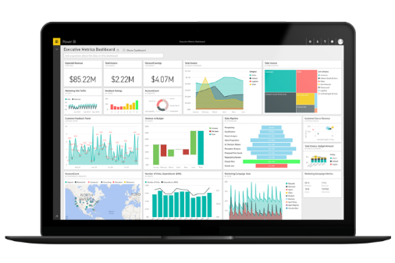


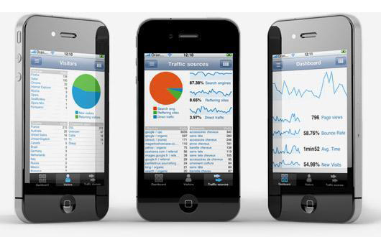
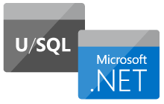
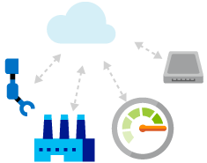
3 Pillars of Azure Data Lake
HDInsight
Visualization
Query
ADLS
ADLA
Notes:
ADLS – cloud-based Hadoop Distributed File System (HDFS) repository, essentially unlimited in size
ADLA – A managed analytics service based on U-SQL, based on Apache YARN
HDInsight – A managed Apache Hadoop, Spark, R, HBase, and Storm cloud service

Slide 6
What is Azure Data Lake?
Comprehensive, cloud-based big data storage and analytics platform
Purpose-built from real-world experiences
Office 365, Skype, Bing, etc.
Leverage existing skills and technologies
Benefits of an Azure-hosted service
Elastic, dynamically provisioned compute resources for varying query needs
Infinite storage capacity
Focus on extracting meaning from data, not on infrastructure
Notes:
Key points:
Big-data as a service
ADL was not invented out of thin air
Based on real-world experiences of real-world product teams at Microsoft
Based on open-source technologies
Immediately apply existing skills like Pig, Hive, R, etc
And/or you can choose to opt into newer MS-specific offerings like U-SQL that offer unique features and potentially smaller learning curve
Abstracts infrastructure

Slide 7
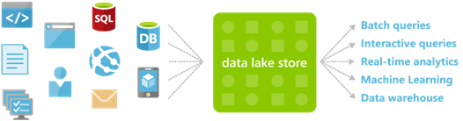
Data Lake Store
HDFS-as-a-service
Durable, redundant storage
A variety of data scenarios
Unlimited capacity
High-volume + low-latency (IoT, etc.)
High throughput (massively parallel query)
Store data in its native format
structured, semi-structured, unstructured storage formats

Slide 8
Data Lake Store – Importing Data

Slide 9




HDInsight
Managed, cloud-scale Apache Hadoop-as-a-service
Full complement of Apache technologies
Spark, Storm, HBase, etc.
Focus on queries and data, not infrastructure
Pay for only what you need and use
Leverage existing skills and toolchains
Hive, Pig, Sqoop, R, etc.
Notes:
Based on the popular Hortonworks Hadoop platform
Wide range of data storage and analysis capabilities
Real-time stream processing
OLTP
Predictive modeling
Interactive analytics.
Abstracts away infrastructure configuration and management
It scales up or down automatically as data size and query complexity requires.
Supports both Windows and Linux cluster types

Slide 10
Data Lake Analytics
Low-barrier alternative (or complement) to HDInsight and Hadoop ecosystem
Scales dynamically to match data size and query complexity
Built on Apache YARN
Unit of interaction is an analytics job
Elastic infrastructure management is abstracted away
U-SQL… query language rooted in SQL and C#
Notes:
- Based on Apache YARN cluster management, job scheduling, and data processing tool
- Interactive SQL
- Real-time streaming
- Data science
- Batch processing
- ADLA job is a U-SQL query issued against one or more configured data sources

Slide 11
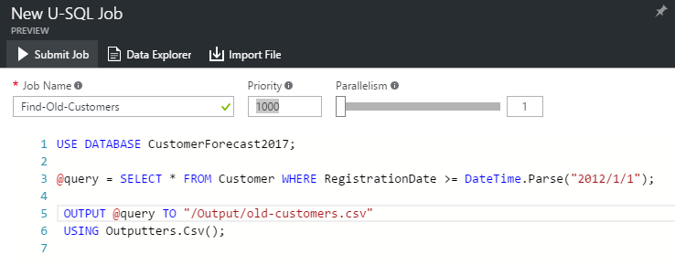
U-SQL
Based on SQL and C#
C# expressions and types
Tables, views, window functions, etc.
User-defined functions/operators/aggregators in C#
Typical job
Read data from named file/table/federated source
Transform rowset in an ordered pipeline
Output rowset to named table or file
Notes:
Built on the learnings from Microsoft’s internal experience with SCOPE and existing languages such as T-SQL, ANSI SQL, Hive, and C#

Slide 12
Data Lake Analytics – U-SQL, Federated Queries, Power BI integration

Slide 13





Azure Ecosystem Integration
Visualization
Federated SQL
Data Discovery
Data Import
Azure Data Lake
Security
Notes:
Federate data from external sources - SQL Data Warehouse, SQL Database, IaaS-hosted SQL Server
Move data into Data Lake Store - Azure Data Factory for ETL, Azure Stream Analytics for streaming data
Power BI for query visualization
Azure Data Catalog for data publishing and discovery
Active Directory for user management and permissions

Slide 14
Pricing
Data Lake Store
$0.04 per GB per month for storage
$0.07 per 1 million transactions
50% preview discount
Data Lake Analytics
$0.017 per ”Analytics Unit” per minute
$0.025 per completed job
50% preview discount
HDInsight - https://azure.microsoft.com/en-us/pricing/details/hdinsight/

Slide 15
References
https://azure.microsoft.com/en-us/services/data-lake-analytics/
https://azure.microsoft.com/en-us/services/data-lake-store/
https://azure.microsoft.com/en-us/services/hdinsight/
http://usql.io/
http://azure.github.io/AzureDataLake/

Slide 16
Thank You!

